Slide 1
Muscles and nerves lower limb

Slide 2
Lumbosacral plexus
Notes:
The list given below does not include all the muscles innervated by these nerves, but only those more commonly tested, either clinically or electrically, and shows the order of innervation

Slide 3
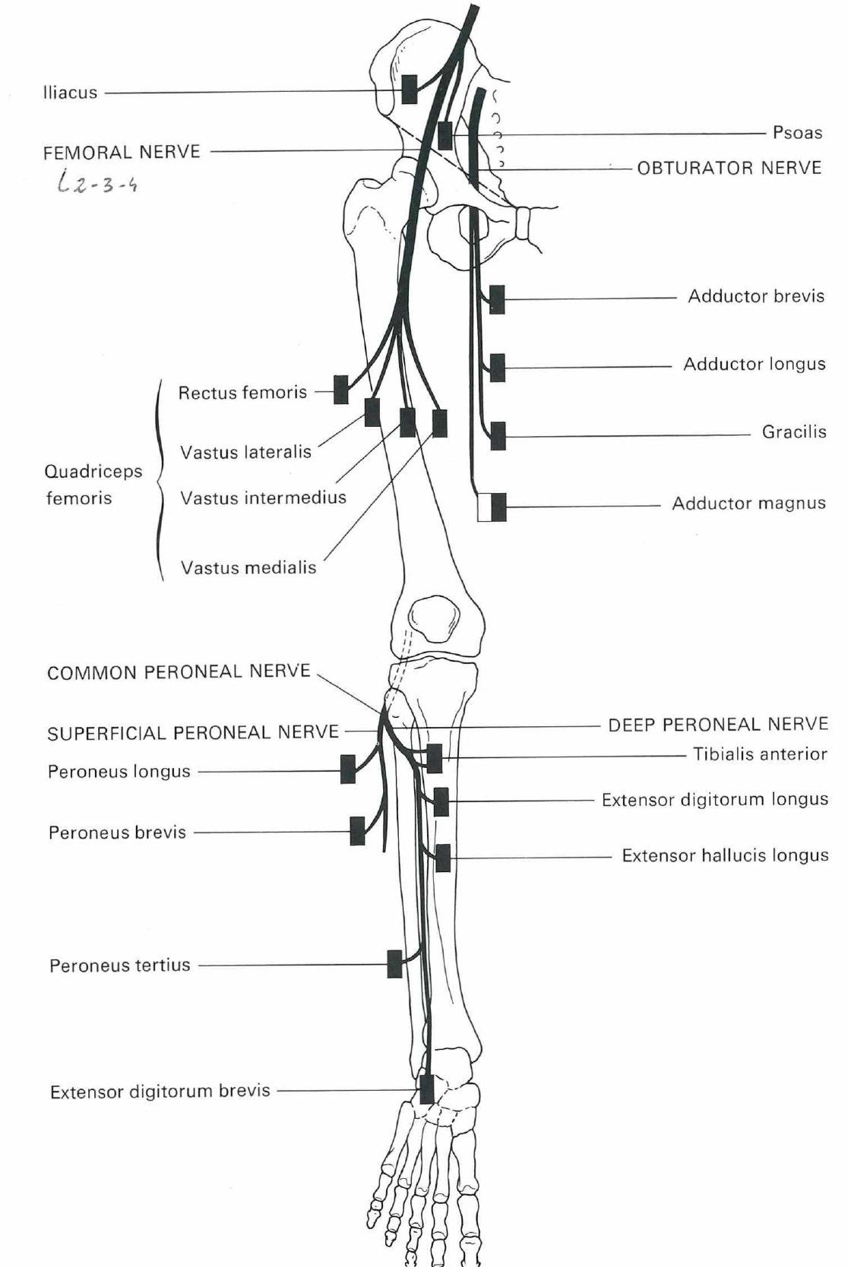
Notes:
The list given below does not include all the muscles innervated by these nerves, but only those more commonly tested, either clinically or electrically, and shows the order of innervation

Slide 4
Notes:
The list given below does not include all the muscles innervated by these nerves, but only those more commonly tested, either clinically or electrically, and shows the order of innervation

Slide 5
Iliopsoas (branches from L1, 2 and 3 spinal nerves and femoral nerve; L1, L2, L3)
Notes:
The patient is flexing the thigh against resistance with the leg flexed at the knee and hip.

Slide 6
Quadriceps femoris (L2, L3, L4)

Slide 7
Adductors (obturator nerve; L2, L3, L4)
Notes:
The patient lies on his back with the leg extended at the knee, and is adducting the limb against resistance. The muscle bellies can be felt.

Slide 8
Gluteus medius and minimus (superior gluteal nerve; L4, L5, S1) 1.

Slide 9
Gluteus medius and minimus (superior gluteal nerve; L4, L5, S1) 2.
Notes:
An alternative method to that illustrated in fig 51. the patient lies on his face with the leg flexed at the knee to a right angle and is internally rotating the limb against resistance. Arrow; the muscle bellies can be felt and sometimes seen

Slide 10
Gluteus medius and minimus and tensor fasciae latae (superior gluteal nerve; L4, L5, S1)

Slide 11
Gluteus maximus (inferior gluteal nerve; L5, S1, S2)
Notes:
The patient lies on his back with the leg extended at the knee and is extending the hip against resistanca. The examiner’sleft hand is feeling the muscle

Slide 12
Gluteus

Slide 13
Hamstring muscles (sciatic nerve, semitendinosus, semimembranosus and biceps; L5, S1, S2)
Notes:
The patient lies on his back with the limb flexed at the hip and knee and is flexing the leg at the knee against resistance

Slide 14
Hamstring muscles (semimembranosus, semitendinosus, biceps femoris, L5 S1 S2)

Slide 15
Gastrocnemius (tibial nerve; S1 S2)
Notes:
The patient lies on his back with the leg extended and is plantar-flexing the foot against resistance. Arrow: the muscle bellies can be seen and felt. To detect slight weakness, the patient should be asked to stand on one foot, raise the heel rom the ground and maintain this position

Slide 16
Soleus (tibial nerve, S1 S2)

Slide 17
Tibialis posterior (tibial nerve; L4 L5)
Notes:
Patient is inverting the foot against resistance. Arrow; the tendon can be seen and felt

Slide 18
Small muscles of the foot (medial and plantar nerves; S1, S2)
Notes:
Patient is cupping the sole of the foot, the small muscles can be felt and sometimes seen

Slide 19
Flexor digitorum longus (tibial nerve, L5 S1 S2)

Slide 20
Tibialis anterior (deep peroneal nerve, L4 L5)

Slide 21
Extensor digitorum longus (deep peroneal nerve, L5 S1)
Notes:
The patient is dorsiflexing the toes against resistance. The tendons passing to the lateral four toes can be seen and felt.

Slide 22
Extensor digitorum brevis (deep peroneal nerve; L5 S1)
Notes:
The patient is dorsiflexing the proximal phalanges of the toes against resistance, arrow: the muscle belly can be felt and sometimes seen

Slide 23
Extensor hallucis longus (peroneus profundus, L5)

Slide 24
Peroneus longus (deep peroneal, L5 S1)

Slide 25
Femoral nerve
Notes:
Approximate area within which sensory changes may be found in lesions of the femoral nerve. The distribution of the intermediate and medial cutaneous nerve of the thigh and the saphenous nerve

Slide 26
Lateral Femoral cutaneous nerve (L2, L3)

Slide 27
Posterior femoris cutaneous (L2, L3)

Slide 28
Lesions of trunc of sciatic nerve
Notes:
Approximate area within which sensory changes may be found in lesions of the trunk of the sciatic nerve. Light touch, continuous line; pin-prick, dotted line

Slide 29
Post. Fem. Cut. L2L3 – Suralis S1S2

Slide 30
Common peroneal nerve
Notes:
Approximate area within which sensory chages may be found in lesions of the common peroneal nerve above the origine of the superficial peroneal nerve. Light touch, continuous line; pin-prick, dotted line

Slide 31
Deep peroneal (L4 L5)

Slide 32
Sural nerve, lat dors cut (S1 S2)
Notes:
The approximate area within which sensory changes may be found in lesions of the sural nerve

Slide 33
Tibial nerve med calc S1 S2 – lat calc
Notes:
The approximate area within which sensory changes may be found in lesions of the tibial nerve. Light touch, continuous line; pin-prick, dotted line.

Slide 34
Dermatomes

Slide 35
Approximate distribution of dermatomes on the perineum

Slide 36
Nerve and main root supply of muscles lower limb

